Slide 1

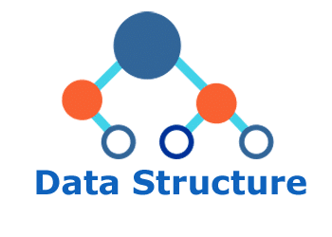
Data structure
(in c)
Lecture 2

Slide 2

Today’s Agenda
What is an Array?
What is an Stack?
Terminologies related to Stack.
Diagrammatic view of Stack.

Slide 3
What is an Array?
Array is a linear Data Structure.
Array is a Homogeneous collection of multiple data items.
Open from both the ends.
It is indexed based data structure .
It allow random access.

Slide 4
Declaring an Array
#include <conio.h>
#include<stdio.h>
void main()
{
int arr[5];
int i;
for(i=0;i<5;i++)
{
……
……
}
getch();
}
0 1 2 3 4
arr
10 | 20 | 30 | 40 | 50
int i
index

Slide 5
What is a Stack?
A Stack is a linear Data Structure developed by
Programmer like an array.
Stack is a restricted form of Array.
Stack is Open from one end only and closed from the other end .
Stack doesn’t allow random access of data, rather the data is accessed in the sequential manner.
Like array it is also a homogeneous collection of elements.
Like array it is also index based.

Slide 6
Terminologies related to Stack
PUSH
POP
LIFO
PEEP
TOS
OVERFLOW
UNDERFLOW

Slide 7
PUSH, POP & LIFO
PUSH - Push is a process of inserting elements in the Stack, one at a time.
POP - Pop is the process of removing elements from the Stack, one at a time.
LIFO - Since stack is open from one end only, the element inserted(PUSHED) last will be the one to be removed(POPPED) first. Thus we say a stack is based on LAST IN FIRST OUT order.

Slide 8
PEEP, TOS, OVERFLOW & UNDERFLOW
PEEP: The process of accessing (not removing) the top elements of the stack.
TOS: It is just a variable of type int, which holds the indexes of the stack. All the PUSH and POP operations take place at the index pointed by TOS. Initially TOS will be at index -1.
OVERFLOW & UNDERFLOW: These are conditions which arise when we try to PUSH data in a FULL STACK, or we try to POP data from an EMPTY stack, Respectively.

Slide 9
Diagrammatic View Of a Stack
push(10);
push(20);
4
3
2
1
0
4
3
2
1
0
10
4
3
2
1
0
20
10
1
0
tos
arr
-1
arr
tos
arr
tos

